Slide 1
18CYM101T- Environmental Science
S.Vignesh,M.E.,(Ph.D.)
Asst. Prof/Mech

Slide 2
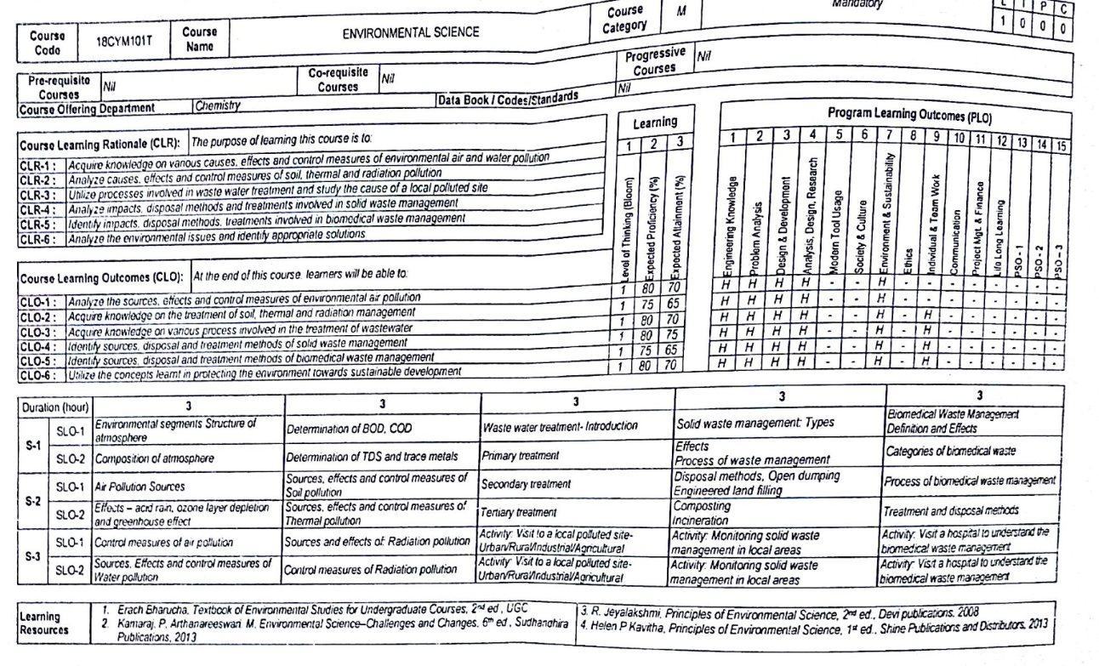
Syllabus

Slide 3
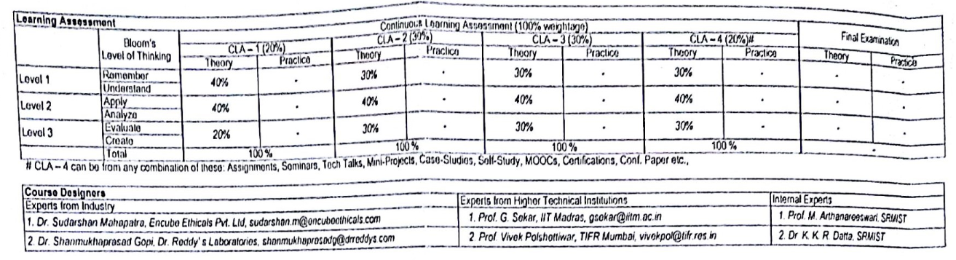

Slide 4
ENVIRONMENTAL SEGMENTS STRUCTURE OF ATMOSPHERE
Components of environment.jfif
REgions of ATM.jfif

Slide 5
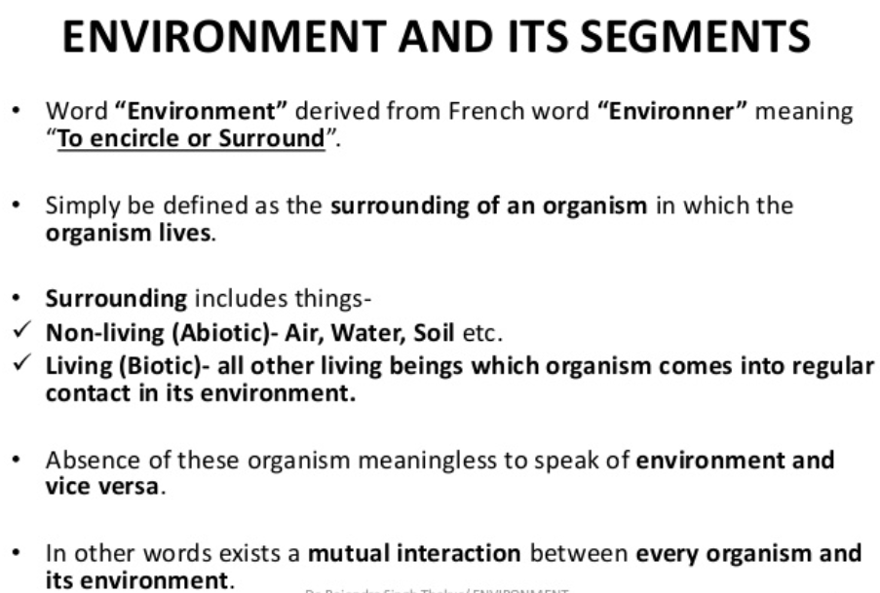

Slide 6
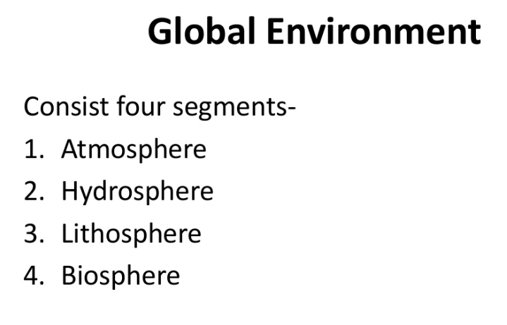

Slide 7
Air Pollution
Sources
Effects
Control

Slide 8
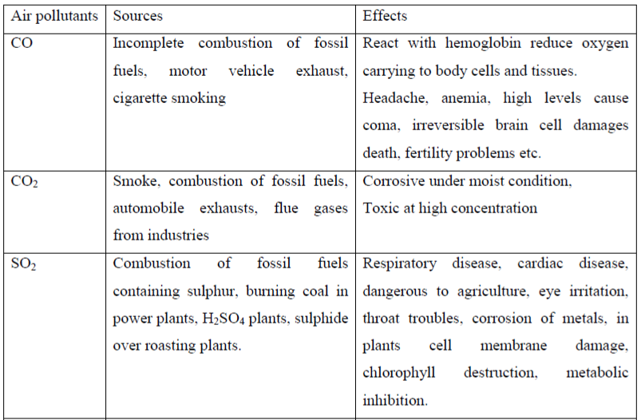
Sources and effects of Air Pollution

Slide 9
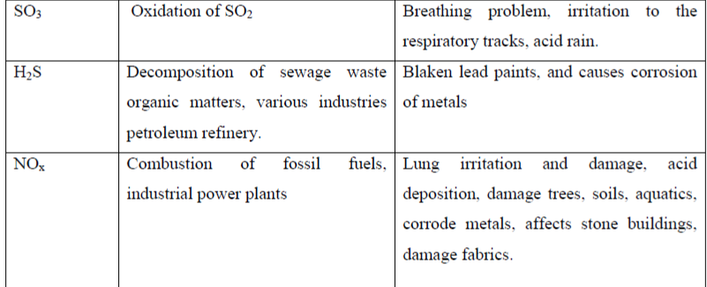

Slide 10
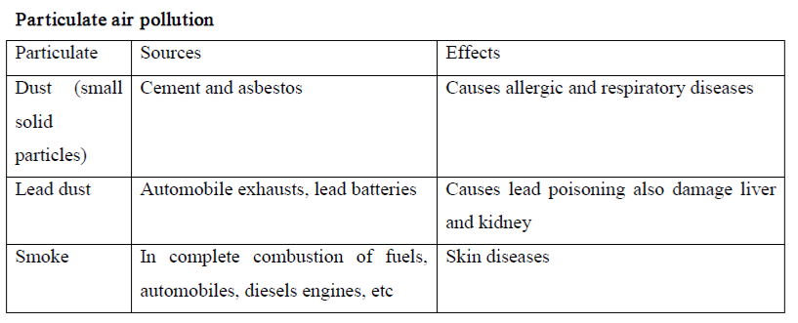

Slide 11
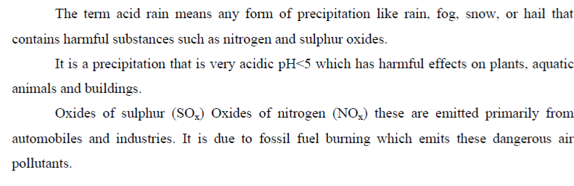
ACID RAIN

Slide 12
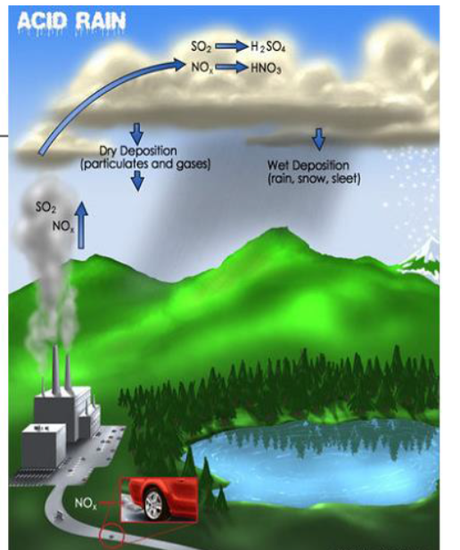

Slide 13
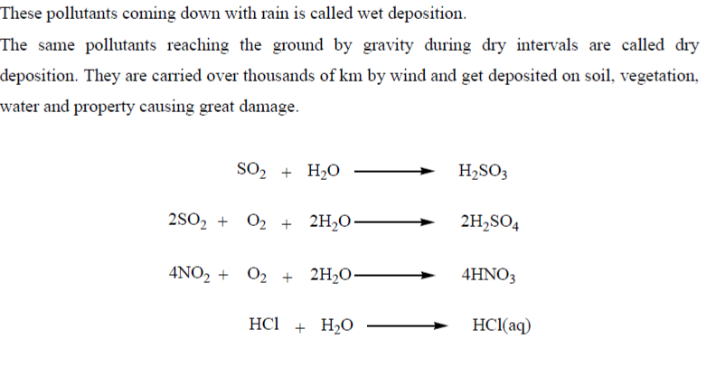

Slide 14
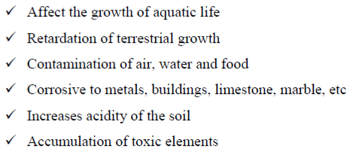

Slide 15
Environmental Protection Act 1986
Environment Protection Act,1986 is an Act of the Parliament of India. In the wake of the Bhopal Tragedy, the Government of India enacted the Environment Protection Act of 1986 under Article 253 of the Constitution.
Passed in March 1986, it came into force on 19 November 1986.
The areas on which restriction has been imposed by this act include Doon Valley in Uttarakhand, Aravali Regions in Alwar, Rajasthan, Coastal zones and ecologically sensitive zones, etc
Air (Prevention and Control of Pollution) Act Forest Conservation Act, 1980 Wildlife Protection Act, 1972 Water Protection Act, 1974

Slide 16
COASTAL REGULATION ZONE(CRZ)
On 8 May 2019, the Supreme Court of India ordered five apartments in Maradu municipality in Kerala to be demolished within one month, for violation of Coastal Regulation Zone (CRZ) rules, however, only four of these apartments had been constructed.
1991 In February 1991, a notification was issued by the Ministry of Environment and Forests (MoEF) under the Environment Protection Act, 1986. This was for the regulation of activities in the coastal area. As per the notification, four categories of Coastal Regulation Zones (CRZ) were defined. CRZ I, CRZ II, CRZ III and CRZ IV

Slide 17
CRZ I areas are those "areas that are ecologically sensitive and important, such as... wildlife habitats, mangroves,... coral reefs, ...close to breeding and spawning grounds of fish and other marine life, ...rich in genetic-diversity, ...likely to be inundated due to rise in sea level consequent upon global warming and such other areas as may be declared
CRZ II areas are those "that have already been developed upto or close to the shoreline." "Developed area" is defined as "...area within the municipal limits or in other legally designated urban areas which is already substantially built up and which has been provided with drainage and approach roads and other infrastructural facilities, such as water supply and sewerage mains

Slide 18
ACID RAIN
Acid rain is a rain or any other form of precipitation that is unusually acidic, meaning that it has elevated levels of hydrogen ions (low pH).
It can have harmful effects on plants, aquatic animals and infrastructure. Acid rain is caused by emissions of sulfur dioxide and nitrogen oxide, which react with the water molecules in the atmosphere to produce acids.
Nitrogen oxides can also be produced naturally by lightning strikes, and sulfur dioxide is produced by volcanic eruptions.
Acid rain has been shown to have adverse impacts on forests, freshwaters and soils, killing insect and aquatic life-forms, causing paint to peel, corrosion of steel structures such as bridges, and weathering of stone buildings and statues as well as having impacts on human health.

Slide 19
"Acid rain" is a popular term referring to the deposition of a mixture from wet (rain, snow, sleet, fog, cloudwater, and dew) and dry (acidifying particles and gases) acidic components.
Distilled water, once carbon dioxide is removed, has a neutral pH of 7. Liquids with a pH less than 7 are acidic, and those with a pH greater than 7 are alkaline. "Clean" or unpolluted rain has an acidic pH, but usually no lower than 5.7, because carbon dioxide and water in the air react together to form carbonic acid, a weak acid according to the following reaction:

Slide 20
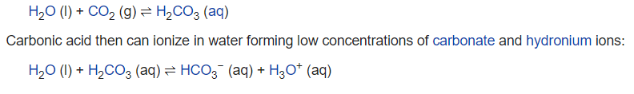

Slide 22
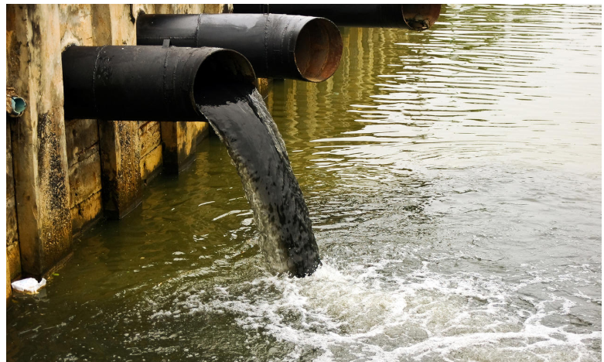
Water Pollution

Slide 23
Water pollution occurs when harmful substances—often chemicals or microorganisms—contaminate a stream, river, lake, ocean, aquifer, or other body of water, degrading water quality and rendering it toxic to humans or the environment.
Causes:
Water is uniquely vulnerable to pollution. Known as a “universal solvent,” water is able to dissolve more substances than any other liquid on earth.
It’s also why water is so easily polluted. Toxic substances from farms, towns, and factories readily dissolve into and mix with it, causing water pollution.

Slide 24
CATEGORIES:
Groundwater
Surface water
Ocean water
Point source, Nonpoint source,Transboundary

Slide 25
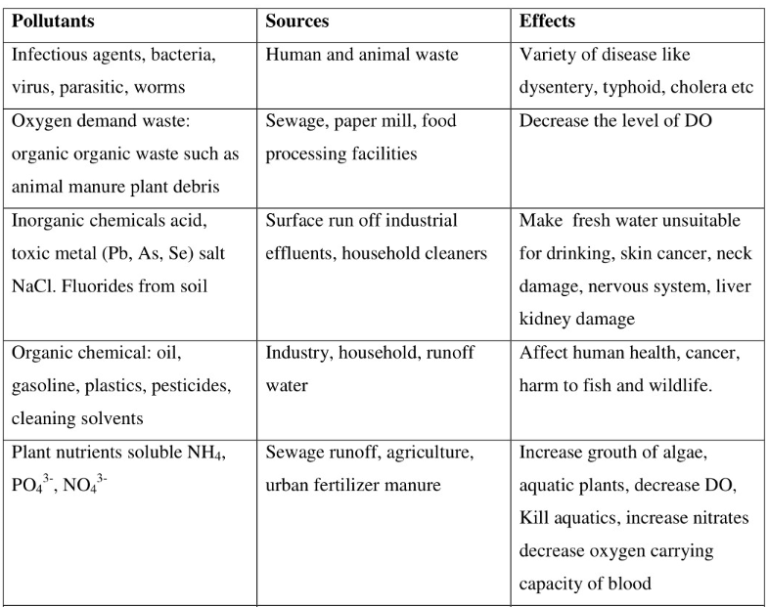

Slide 26
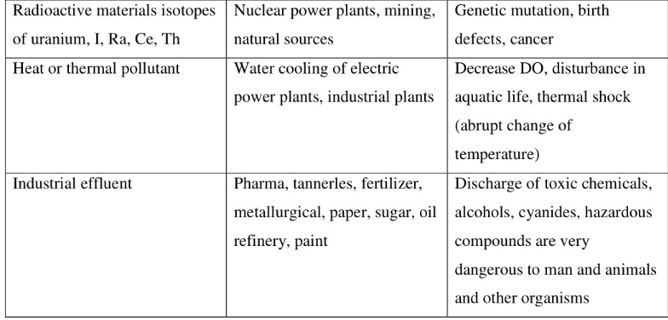

Slide 27
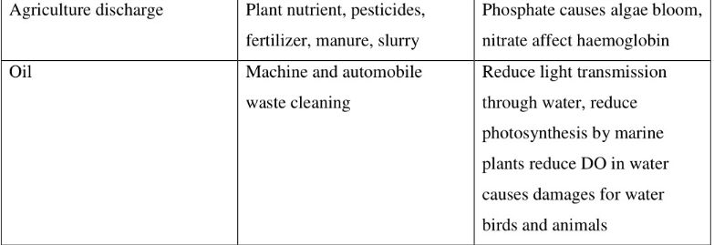

Slide 28
BOD & COD
COD or Chemical Oxygen Demand is the total measurement of all chemicals (organics & in-organics) in the water / waste water;
BOD is a measure of, the amount of oxygen that require for the bacteria to degrade the organic components present in water / waste water.

Slide 29
